Slide 1

Predicting Hotel Cancellations
By Bret Jaco, Chaitra Setty, Luna Cui, Matthew Tran, Soumya Nayak

Slide 2
1
2
3
4
5
6
Agenda
Business Problem
Exploratory Data Analysis
Modeling
Causal Effect and Counterfactuals
Conclusion
Market Segmentation
Notes:
Slides 1-6 - Chaitra

Slide 3
1
Business Problem

Slide 4
Hotel Industry
Hotel cancellations have increased to more than 40% due to booking flexibility through third-party booking sites
HOTEL
& SPA
Notes:
Booking.com has the highest cancellations, followed by expedia

Slide 5
Impacts of Cancellation
1
2
3
Unsold rooms
Sell for cheaper
Higher distribution costs
Last minute cancellations lead to unsold rooms which is a lost opportunity cost
Cancellations can lead the hotel to discount unsold rooms
Using third party services leads to higher cost

Slide 6
Current Approach
Issues
Overbook the rooms
Strict cancellation policies
Deny services to customers
Less bookings

Slide 7
2
Exploratory Data Analysis
Notes:
Luna - Slides 7-11
Define lead time, ADR, and other terms calculated

Slide 8
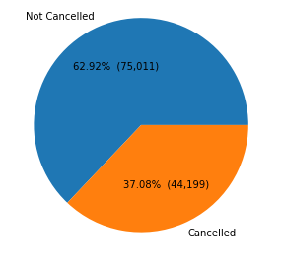
Dataset
~120,000 records including a resort hotel and city hotel
Including 32 features
Categorical: market segment, room type, country...
Numerical: lead time, adr, number of nights...
Target to predict: cancellation (binary)

Slide 9
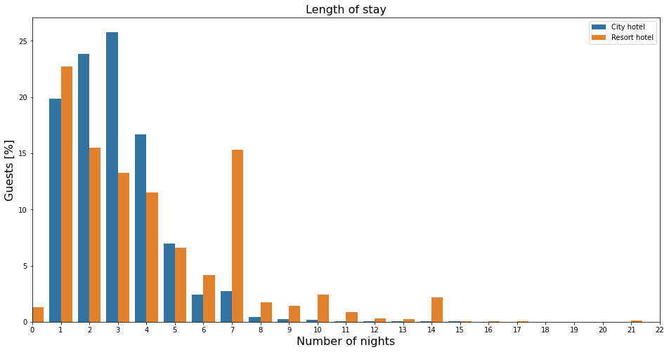
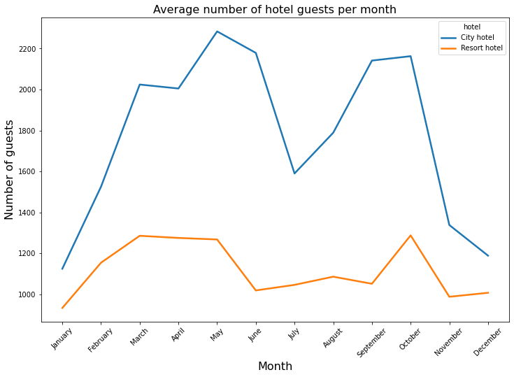
Guest Patterns
1
2
Number of nights stayed
Peaks
Mid Spring and Fall
Most guests choose to stay 1-4 nights

Slide 10
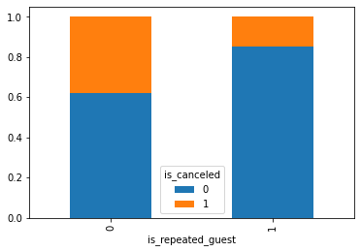
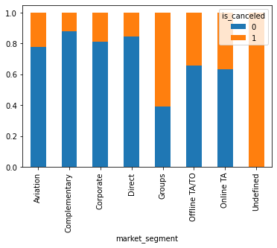
Cancellations By Categorical Variable

Slide 11
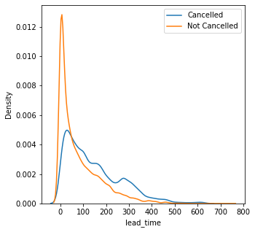
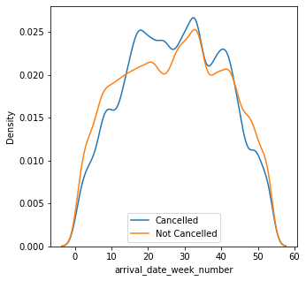
Cancellation By Numerical Variable

Slide 12
Modeling
3
Notes:
Bret - slides 12-17

Slide 13
Data Preprocessing & Model Tuning
1
Categorical Feature Encoding
2
Log-Normalization of Numerical Features
3
Multicollinearity Testing using VIF
4
GridSearch CV for Model Parameter Tuning

Slide 14
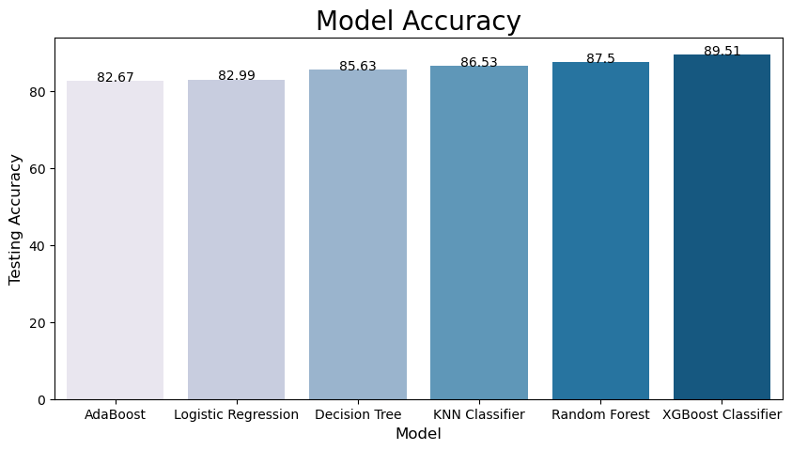
Model Performance
Key Findings
Best models are XGBoost and Random Forest
Logistic Regression and AdaBoost performed poorly, possibly due to outliers
PCA not effective in reducing features

Slide 15
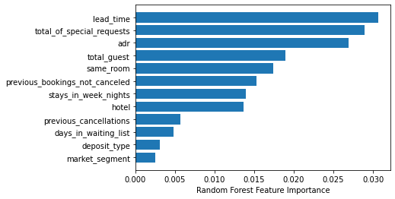
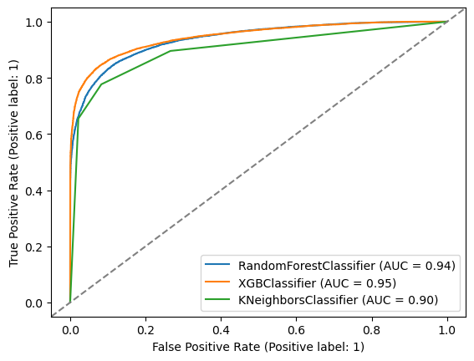
Feature Importance & ROC Curves

Slide 16
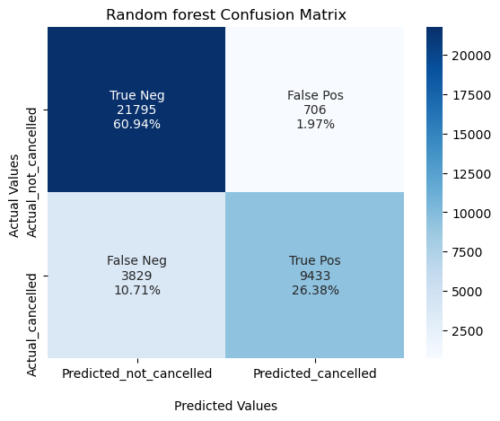
Confusion matrix
Random forest
Notes:
False negative - predicted to not cancel but do cancel
False positive - predicted to cancel but do not

Slide 17
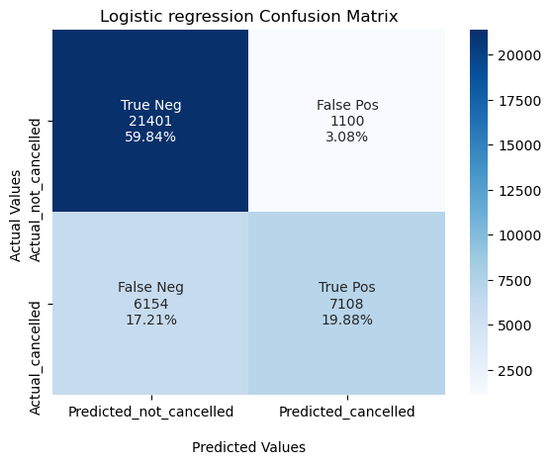
Confusion matrix
Logistic regression

Slide 18
4
Market Segmentation
Notes:
Slides 18-21 - Soumya

Slide 19




Customer Types
Type 1
Type 2
Higher Cancellation Rate(45%)
Higher average Stay Time
Higher Average Daily Rate
Low Cancellation Rate(25%)
Highest average Stay Time
Low average lead time (31 days)
Type 4
Type 3
Low Cancellation Rate(35%)
Highest Average Daily Rate
Lowest average days in waiting list
Highest number of children and babies
Highest Cancellation Rate(64%)
High average Lead Time(326 days)
Highest average days in waiting list(9 days)

Slide 20
05
Causal Effects and Counterfactuals

Slide 21
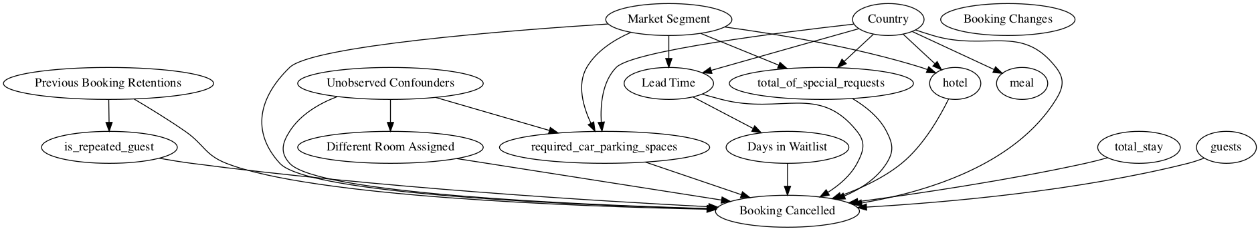
Causal Model
Graph built on assumptions and provided a treatment (different room assigned) and outcome (booking cancelled)
Probability of booking being canceled decreases by 25% when provided a different room than the one booked
Notes:
https://microsoft.github.io/dowhy/example_notebooks/DoWhy-The%20Causal%20Story%20Behind%20Hotel%20Booking%20Cancellations.html
Methods we used to test the results from our assumptions
Random Common Cause:- Adds randomly drawn covariates to data and re-runs the analysis to see if the causal estimate changes or not. If our assumption was originally correct then there shouldn’t much variation in the causal estimate.
Placebo Treatment Refuter:- Randomly assigns any covariate as a treatment and re-runs the analysis. If our assumptions were correct then this newly found out estimate should go to 0.
Data Subset Refuter:- Creates subsets of the data(similar to cross-validation) and checks whether the causal estimates vary across subsets. If our assumptions were correct there shouldn’t be much variation.

Slide 22
Counterfactuals with DiCE
Provides What-if analysis to hotel manager
Is Canceled | Lead time | Market Segment | Customer Type | Deposit Type
0 | 203 | Direct | Transient | No Deposit
Is Canceled | Lead time | Market Segment | Customer Type | Deposit Type
1 | 203 | Direct | Group | No Deposit
1 | 473 | Direct | Undefined | No Deposit
1 | 203 | Corporate | Transient | Non Refund
1 | 503 | Direct | Transient | No Deposit
1 | 536 | Direct | Transient | No Deposit

Slide 23
Next Steps with Counterfactuals
Increase model complexity
Including more features
Use more advanced model to train data
Adjust parameters weight for analysis purpose
Tune parameters for diversity and proximity to generate different kinds of explanations
Proximity: more feasible
Diversity: multiple possible options
HOTEL
& SPA

Slide 24
Conclusion
06
Notes:
Mathew - slides 24-26

Slide 25
Conclusion
The models have about an 89% accuracy
False Positive value is below 3%, which means less than 3% of the time the hotel can run the risk of overbooking
False negative value is below 10%, which means less than 10% of the times, the hotel will be allocating their resources in the wrong reservations that the customer will eventually cancel
Target families and customers booking closer to check in dates
Based on booking trends the overbooking policy can increase in the Fall and Spring months
Notes:
Cancellations and accuracy
Target customers with high chance of cancellation
Adjust booking policy based on timing

Slide 26
Looking Forward
Compare stats with comparable hotels
Incorporate customer reviews
Look at post covid data
Look at airline data to search for other patterns

Slide 27
Thank You
Notes:
Mathew - slides 24-26

Slide 28
Appendix
Notes:
Mathew - slides 24-26

Slide 29
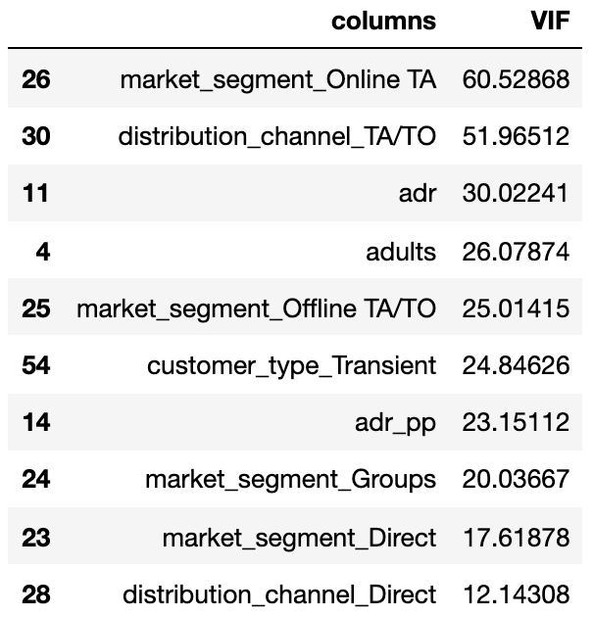
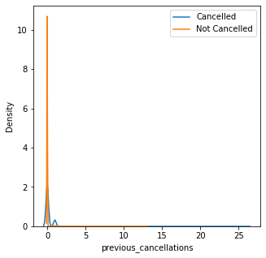
Feature Selection/Transformation
OneHot Encoding
(categorical variables)
VIF analysis
(reduce number of features)
Log-Normalization
(long tail problem)

Slide 30
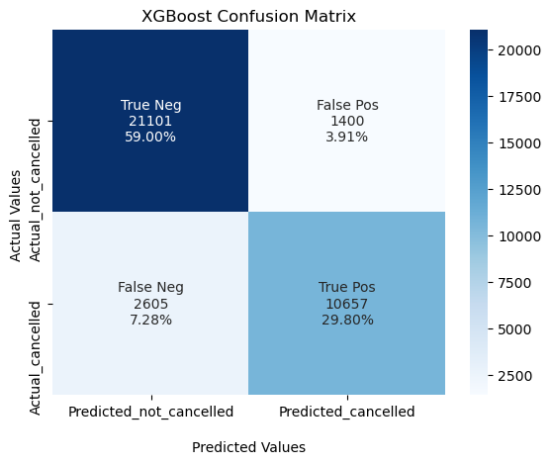
Confusion matrix
XGBoost

Slide 31
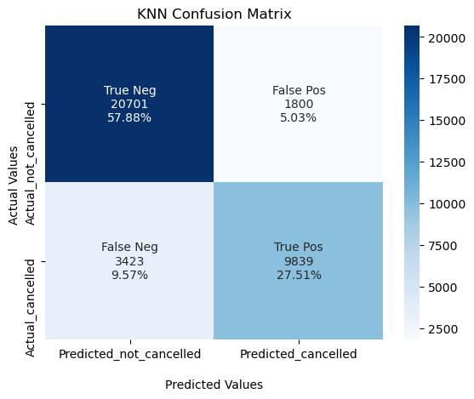
Confusion matrix
KNN

